Slide 1
Illustrator Assignment

Slide 2
Introduction to Adobe Illustrator Interface and Workspace
Theory Assignment:
Overview of Adobe Illustrator
Understanding the Workspace
Setting Up a New Document

Slide 3
Introduction to Adobe Illustrator Interface and Workspace
Overview of Adobe Illustrator
Explain the main uses of Illustrator in the design industry, such as logo creation, vector illustrations, and icon design.

Slide 4
Explain the main uses of illustrator in the design industry, such as logo creation, vector illustrations, and icon design.
Illustrator is widely used in the design industry for:
Logo Creation: Crafting scalable, high-quality logos.
Vector Illustrations: Designing detailed, resolution-independent graphics.
Icon Design: Creating clean, customizable icons.
Typography: Customizing and creating type-based designs.
Infographics: Designing visually appealing data presentations.
Print Design: Producing brochures, posters, and business cards.
Web Graphics: Developing web-friendly vector assets.

Slide 5
Introduction to Adobe Illustrator Interface and Workspace
Understanding the Workspace
Define key elements of the Illustrator workspace: artboards, panels, tools, and properties.
Describe the purpose of the Layers panel and how it helps manage complex designs.

Slide 6
Define key elements of the illustrator workspace: artboards, panels, tools, and properties.
Artboards: Editable canvas areas for design projects.
Panels: Dockable sections for layers, colors, and properties.
Tools: Toolbar for creating and editing graphics.
Properties: Context-sensitive options for selected objects or tools.

Slide 7
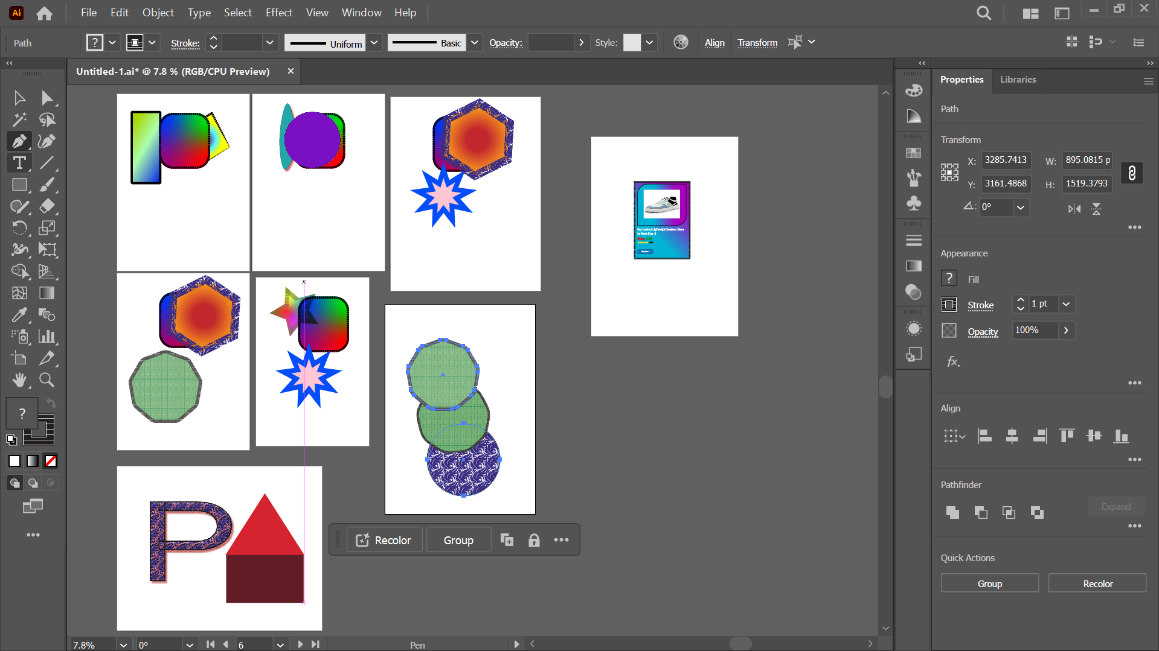
Define key elements of the illustrator workspace: artboards, panels, tools, and properties.

Slide 8
Describe the purpose of the layers panel and how it helps manage complex designs.
The Layers panel in Illustrator serves as a powerful tool for managing complex designs by:
Organizing Elements: Separates objects into layers for a structured workflow.
Visibility Control: Toggle layer visibility to focus on specific elements.
Locking Layers: Prevents accidental edits to specific elements.
Grouping Objects: Enables grouping and sub-layer creation for better hierarchy.

Slide 9
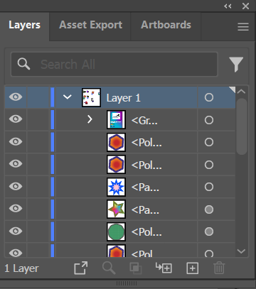
Describe the purpose of the layers panel and how it helps manage complex designs.
Editing Efficiency: Select and edit individual objects without affecting others.
Layer Reordering: Adjust stacking order to control object overlap.
Isolation Mode: Focuses on specific layers or objects for detailed editing.

Slide 10
Introduction to Adobe Illustrator Interface and Workspace
Setting Up a New Document
Explain the steps to create a new document in Illustrator, including selecting document dimensions, orientation, and color mode.
Describe the difference between RGB and CMYK color modes and when to use each.

Slide 11
Explain the steps to create a new document in illustrator, including selecting document dimensions, orientation, and color mode.
Launch Illustrator: Open the application.
Create New Document: Click File > New or press Ctrl+N.
Choose Preset: Select a template or custom settings in the New Document window.
Set Dimensions: Enter width and height values.
Select Orientation: Choose portrait or landscape.
Pick Color Mode: Select RGB for digital or CMYK for print.
Adjust Bleed (Optional): Set bleed margins if needed.
Create Document: Click Create to open the new artboard.

Slide 12
Describe the difference between RGB and CMYK color modes and when to use each.
RGB(Red, Blue, Green)
CYMK(Cyan, Magenta, Yellow, Black)
Used for digital designs like websites, apps, and screens.
Produces vibrant colors by combining light.
Best for on-screen use as screens emit light.
Use RGB for digital projects and designs meant for screens.
Used for print designs like brochures, posters, and packaging.
Uses ink to subtract light, suitable for physical media.
Ensures accurate color reproduction in printing.
Use CMYK for designs intended for printing to ensure proper color output.

Slide 13
Introduction to Adobe Illustrator Interface and Workspace
Practical Assignment:
Workspace Exploration
Customizing the Workspace

Slide 14
Introduction to Adobe Illustrator Interface and Workspace
Customizing the Workspace
Screenshot your customized workspace layout and explain why you arranged the tools in this way.

Slide 15
Working with Shapes and the PenTool
Theory Assignment:
Basic Shape Tools
The Pen Tool
Pathfinder Tool
The Pencil Tool

Slide 16
Introduction to Adobe Illustrator Interface and Workspace
Basic Shape Tools
Describe the Rectangle, Ellipse, Polygon, and Star tools, explaining how each shape can be used in designs.
Explain how the Shape Builder tool helps combine and manipulate shapes.

Slide 17
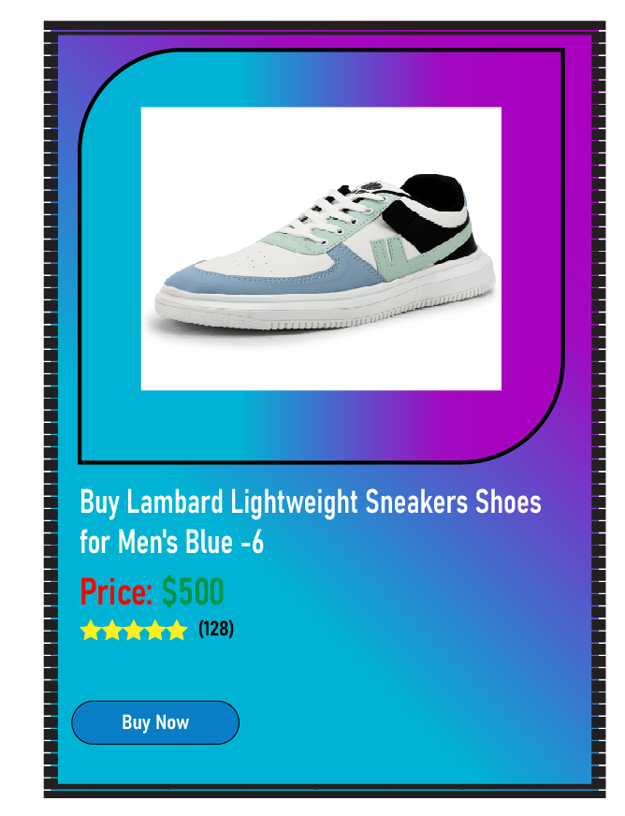
Describe the rectangle, ellipse, polygon, and star tools, explaining how each shape can be used in designs.
Rectangle Tool: Creates squares or rectangles; used for backgrounds, buttons, and layout structures.
Ellipse Tool: Draws circles or ovals; great for logos, icons, and decorative elements.
Polygon Tool: Makes polygons with adjustable sides; ideal for badges, charts, and unique shapes.
Star Tool: Creates stars with customizable points; used for highlights, decorative elements, or branding.

Slide 18
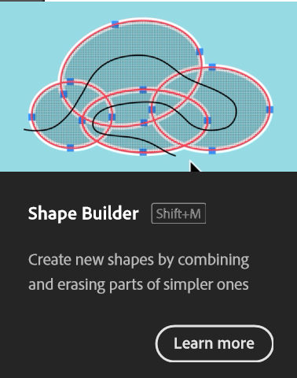
Explain how the shape builder tool helps combine and manipulate shapes.
Combining Shapes: Drag across overlapping areas to merge them into a single shape.
Subtracting Areas: Hold Alt (Windows) or Option (Mac) and click unwanted areas to remove them.
Creating New Shapes: Isolate specific segments by selecting and splitting overlapping shapes.
Streamlining Workflows: Eliminates the need for complex path operations with intuitive interactions.

Slide 19
Introduction to Adobe Illustrator Interface and Workspace
The Pen Tool
Define the Pen tool and describe its purpose in creating custom shapes and paths.
Explain the difference between anchor points, handles, and paths.

Slide 20
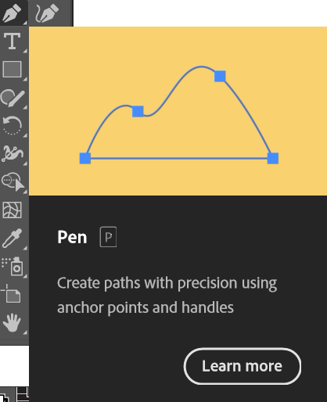
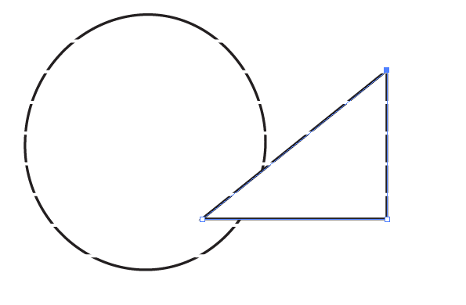
Define the pen tool and describe its purpose in creating custom shapes and paths.
The Pen tool is a vector-based drawing tool used to create precise paths and shapes.
It allows you to create smooth curves and straight lines by placing anchor points and manipulating their handles. This makes it ideal for creating logos, illustrations, and complex selections.

Slide 21
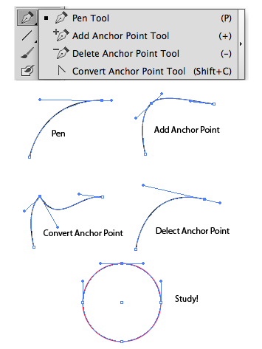
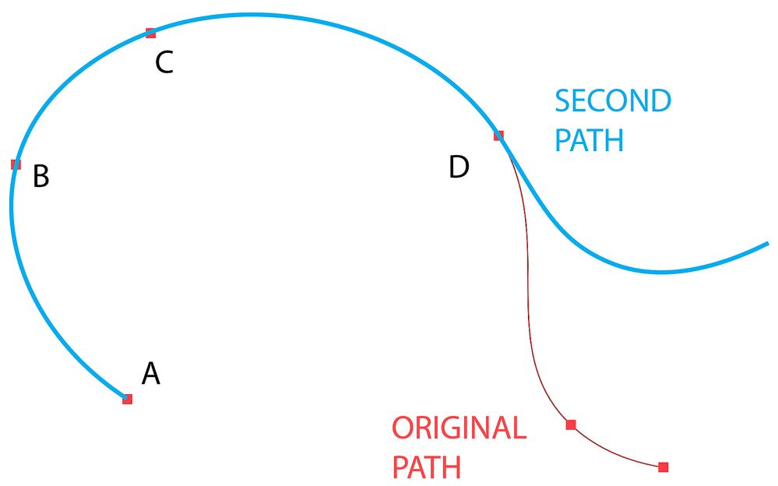
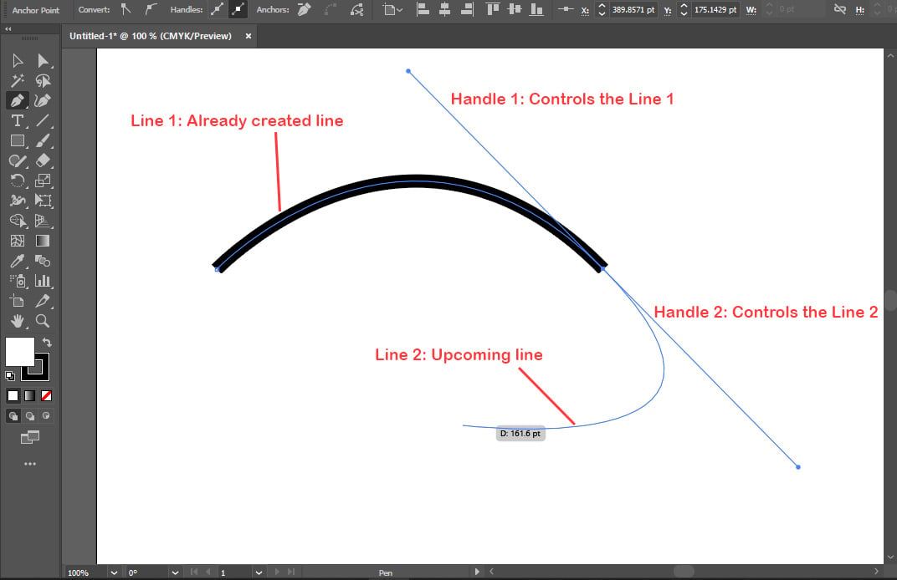
Explain the difference between anchor points, handles, and paths.
Anchor Points: These are the corner points of a path. They determine the shape and direction of the path.
Handles: These are the lines that extend from anchor points. They control the curvature of the path between anchor points.
Paths: These are the lines that connect anchor points. They form the outline of a shape.

Slide 22
Introduction to Adobe Illustrator Interface and Workspace
Pathfinder Tool
Explain how the Pathfinder tool is used for combining and subtracting shapes.
Describe the differences between the Unite, Minus Front, Intersect, and Exclude options in Pathfinder.

Slide 23
Explain how the pathfinder tool is used for combining and subtracting shapes.
The Pathfinder tool in Adobe Illustrator is a powerful tool for combining and subtracting shapes.
Combining Shapes:
Unite: This operation merges multiple shapes into a single, unified shape. The resulting shape will have the combined area of all the selected shapes.
Add: This operation is similar to Unite, but it preserves the individual shapes within the group. This allows you to edit the individual shapes later without affecting the combined shape.

Slide 24
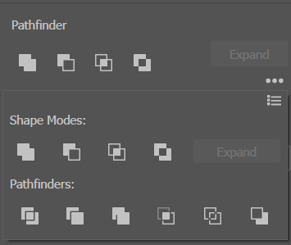
Explain how the pathfinder tool is used for combining and subtracting shapes.
Subtracting Shapes:
Minus Front: This operation subtracts the topmost shape from the shape below it. This is useful for creating cutouts and other complex shapes.
Intersect: This operation creates a new shape from the overlapping areas of two or more shapes.
Exclude: This operation creates a new shape from the non-overlapping areas of two or more shapes

Slide 25
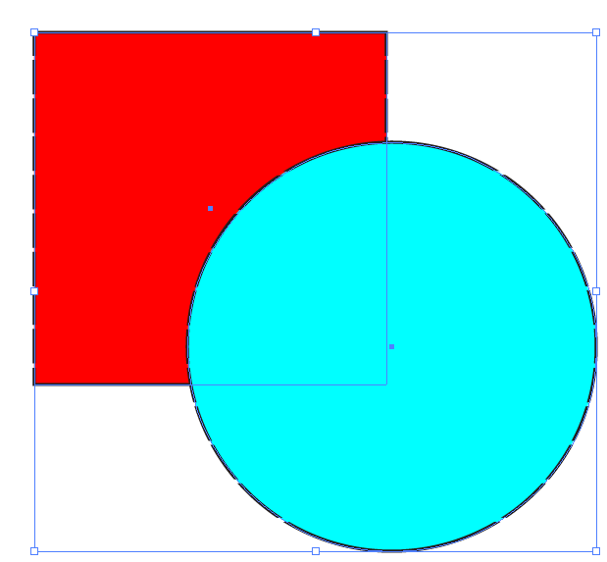
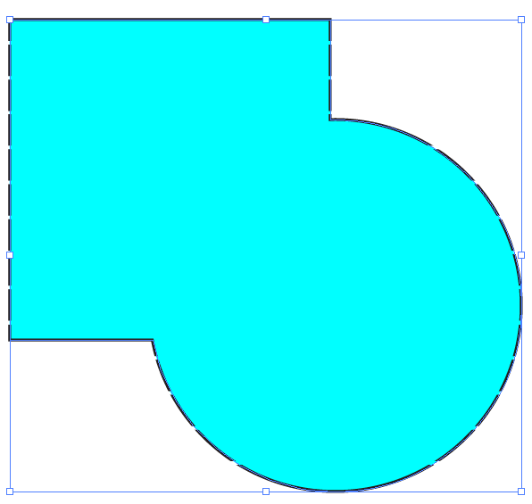
Describe the differences between the unite, minus front, intersect, and exclude options in pathfinder.
Unite:
Purpose: Combines multiple shapes into a single, unified shape.
Result: A single shape with the combined area of all selected shapes.
Example: Combining several smaller shapes to form a larger, more complex shape.
Before
After

Slide 26
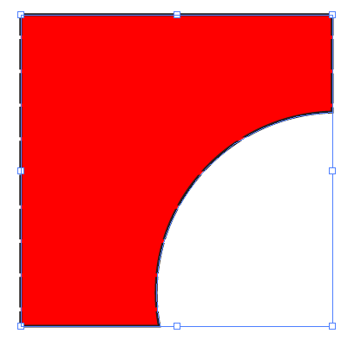
Describe the differences between the unite, minus front, intersect, and exclude options in pathfinder.
Minus Front:
Purpose: Subtracts the topmost shape from the shape below it.
Result: Creates a cutout or removes a portion of the bottom shape based on the shape of the topmost shape.
Example: Creating an arc in a rectangle by placing a circle on top and using Minus Front.
Before
After

Slide 27
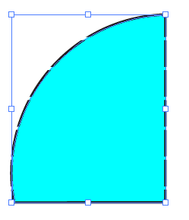
Describe the differences between the unite, minus front, intersect, and exclude options in pathfinder.
Intersect:
Purpose: Creates a new shape from the overlapping areas of two or more shapes.
Result: A shape that only includes the areas where the selected shapes intersect.
Example: Creating a custom shape by overlapping rectangles and circle using Intersect to keep only the overlapping area.
Before
After

Slide 28
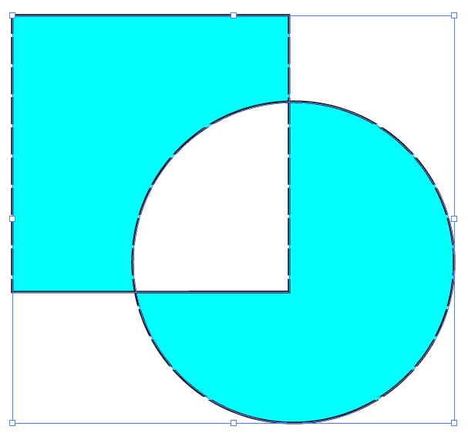
Describe the differences between the Unite, Minus Front, Intersect, and Exclude options in Pathfinder.
Exclude:
Purpose: Creates a new shape from the non-overlapping areas of two or more shapes.
Result: A shape that includes all parts of the selected shapes except for the areas where they overlap.
Example: Creating a shape that is the opposite of an intersection, keeping the parts of the shapes that don't overlap.
Before
After

Slide 29
Introduction to Adobe Illustrator Interface and Workspace
The Pencil Tool
Define the Pencil tool and describe its purpose in creating custom Typeface modification

Slide 30
Define the pencil tool and describe its purpose in creating custom typeface modification.
The Pencil tool in Illustrator is used for freehand drawing. While not directly for typeface editing, it helps in:
Sketching initial ideas: Capturing organic shapes for inspiration.
Creating custom brushes: Adding texture and personality to type.
Vectorizing handwritten fonts: Converting handwritten characters into editable vectors.

Slide 31
Working with Shapes and the PenTool
Practical Assignment:
Creating Custom Shapes with the Pen Tool
Shape Builder Exercise
Pathfinder Tool Practice
Pencil Tool Practice

Slide 32
Introduction to Adobe Illustrator Interface and Workspace
Creating Custom Shapes with the Pen Tool
Create a complex design using overlapping basic shapes (circles, rectangles, etc.).
Use the Shape Builder tool to merge or subtract parts of the shapes, creating a unique composition.

Slide 33
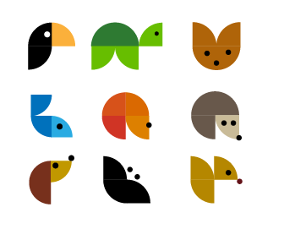
Using the pen tool, create a simple icon (e.g., A house or tree) by combining shapes and paths. Apply colors and strokes to the design, experimenting with various stroke weights and fills.

Slide 34
Introduction to Adobe Illustrator Interface and Workspace
Shape Builder Exercise:
Create a complex design using overlapping basic shapes (circles, rectangles, etc.).
Use the Shape Builder tool to merge or subtract parts of the shapes, creating an unique composition.

Slide 35
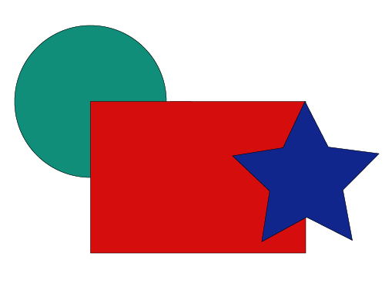
Create a complex design using overlapping basic shapes (circles, rectangles, etc.).

Slide 36
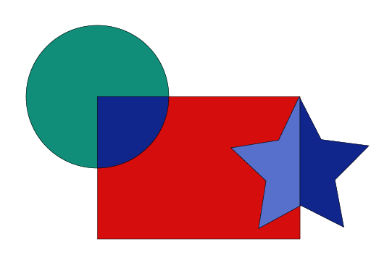
Use the Shape Builder tool to merge or subtract parts of the shapes, creating an unique composition.

Slide 37
Introduction to Adobe Illustrator Interface and Workspace
Pathfinder Tool Practice
Design a logo by combining and subtracting shapes using the Pathfinder tool.
Apply different colors and gradients to each part of the logo for added depth.

Slide 38

Design a logo by combining and subtracting shapes using the Pathfinder tool.

Slide 39

Apply different colors and gradients to each part of the logo for added depth.

Slide 40
Color, Gradients, and the Swatches Panel
Theory Assignment:
Color Theory Basics in Illustrator
Using Gradients
Color Guide Panel

Slide 41
Color, Gradients, and the Swatches Panel
Color Theory Basics in Illustrator:
Explain the difference between fills and strokes and how they are applied to objects.
Describe the role of the Swatches panel and how it helps manage colors in a design.

Slide 42
Explain the difference between fills and strokes and how they are applied to objects.
Fill: This is the color that fills the inside of the object. Imagine it as the paint covering the area within the object's outline.
Stroke: This is the color of the object's outline or border. It's like the line drawn around the edge of the object.
How They're Applied:
Select an object.
Choose a color or effect for the fill.
Choose a color or effect for the stroke.
Adjust stroke weight and style if needed.

Slide 43
Describe the role of the Swatches panel and how it helps manage colors in a design.
Swatches Panel: The Swatches panel is your color management hub. It's a collection of pre-defined colors, gradients, and patterns that you can quickly apply to your objects.
Here's how it helps:
Color Library: Provides a wide range of colors to choose from, often organized into categories (e.g., web-safe colors, CMYK colors).
Consistency: Makes it easy to maintain a consistent color palette throughout your design. If you need to change a color, you can edit the swatch, and all objects using that swatch will update automatically.
Organization: Allows you to create custom swatches and organize them into groups for different projects or design elements.

Slide 44
Color, Gradients, and the Swatches Panel
Using Gradients:
Define gradients and explain the difference between linear and radial gradients.
Describe how the Gradient tool and Gradient panel work together to create smooth color transitions.

Slide 45
Define gradients and explain the difference between linear and radial gradients.
Gradients: Gradients are a way to smoothly blend two or more colors together. Instead of a solid color, you get a gradual transition between hues. This can add depth, visual interest, and a sense of dimension to your designs.
Linear vs. Radial Gradients
Linear Gradient: Colors transition along a straight line. Imagine it like a color bar where one color smoothly fades into the next. You can control the angle of this line (e.g., horizontal, vertical, diagonal).
Radial Gradient: Colors transition outward from a central point. Think of it like a bullseye or a ripple effect, where colors radiate from the center. You can control the shape (circle, ellipse) and size of the gradient.

Slide 46
Describe how the Gradient tool and Gradient panel work together to create smooth color transitions.
Gradient Tool: This tool lets you apply and adjust gradients directly on your objects. You can click and drag to change the gradient's direction or position.
Gradient Panel: This panel provides detailed settings for your gradients.
You can:
Choose the gradient type (linear or radial).
Add or remove color stops (the points where colors change).
Adjust the color of each stop.
Control the blending between colors.
In short: The Gradient tool lets you interactively manipulate gradients, while the Gradient panel gives you fine-grained control over their properties.

Slide 47
Color, Gradients, and the Swatches Panel
Color Guide Panel:
Explain the Color Guide panel and how it assists in choosing harmonious colors for designs.
Describe what complementary, analogous, and triadic color schemes are.

Slide 48
Explain the Color Guide panel and how it assists in choosing harmonious colors for designs.
Color Guide Panel:
The Color Guide panel is a helpful tool for creating harmonious color palettes. It analyzes the colors you've already used in your design and suggests related colors that will likely look good together.
It offers various color harmony rules (like complementary, analogous, etc.) and lets you adjust the color variations (like tints, shades, and tones).
This takes the guesswork out of color selection and helps ensure your designs have a cohesive and visually appealing color scheme.

Slide 49
Describe what complementary, analogous, and triadic color schemes are.
Color Schemes
Complementary: These colors are opposite each other on the color wheel (e.g., red and green, blue and orange). They create high contrast and a vibrant look.
Analogous: These colors are next to each other on the color wheel (e.g., blue, blue-green, green). They create a calm and harmonious feel.
Triadic: These colors are evenly spaced on the color wheel, forming a triangle (e.g., red, yellow, blue).
They offer a balanced and vibrant palette.
Sources and related content

Slide 50
Color, Gradients, and the Swatches Panel
Practical Assignment:
Applying Colors and Swatches
Gradient Application
Color Guide Exercise

Slide 51
Color, Gradients, and the Swatches Panel
Applying Colors and Swatches:
Create a colorful design using a combination of basic shapes.
Use the Swatches panel to save and apply a custom color palette to the shapes.

Slide 52
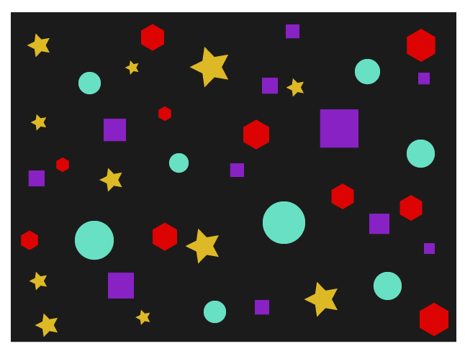
Create a colorful design using a combination of basic shapes.

Slide 53

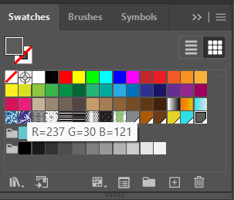
Use the Swatches panel to save and apply a custom color palette to the shapes.

Slide 54
Color, Gradients, and the Swatches Panel
Gradient Application:
Design a sunset or sunrise scene using linear and radial gradients to create smooth color transitions.
Experiment with gradient stops and transparency settings to achieve a realistic effect.

Slide 55

Design a sunset or sunrise scene using linear and radial gradients to create smooth color transitions. Experiment with gradient stops and transparency settings to achieve a realistic effect.

Slide 56
Color, Gradients, and the Swatches Panel
Color Guide Exercise:
Choose a primary color and use the Color Guide panel to create a complementary color scheme.
Apply this color scheme to a design of your choice, such as a logo or simple illustration.

Slide 57
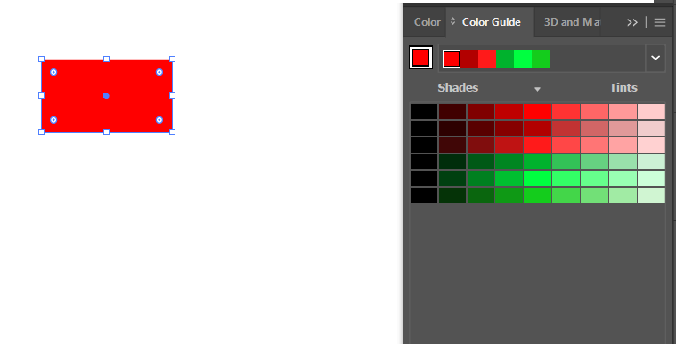
Choose a primary color and use the Color Guide panel to create a complementary color scheme.

Slide 58
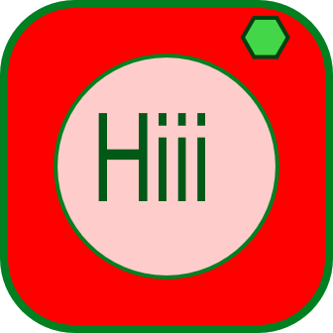
Apply this color scheme to a design of your choice, such as a logo or simple illustration.

Slide 59
Typography and Text in Illustrator
Theory Assignment:
Introduction to Typography in Illustrator
Type on a Path
Character and Paragraph Panels

Slide 60
Typography and Text in Illustrator
Introduction to Typography in Illustrator:
Describe the Type tool and its primary uses in Illustrator.
Explain the importance of typography in design, including readability, hierarchy, and style

Slide 61
Describe the Type tool and its primary uses in Illustrator.
Type Tool
The Type tool in Illustrator is your go-to for adding text to your designs. You can create text in several ways:
Point Type: Click once to create a single line of text. Good for headlines or short labels.
Area Type: Click and drag to create a text box. Useful for paragraphs or longer blocks of text.
Path Type: Click on a path (like a circle or a wavy line) to make the text flow along that path. Great for creative text layouts.

Slide 62
Explain the importance of typography in design, including readability, hierarchy, and style
Typography is much more than just putting words on a page. It's a crucial element of design that impacts how your message is received.
Here's why it's important:
Readability: Choosing the right font, size, and spacing makes your text easy to read and understand. If people can't read it, they won't get your message.
Hierarchy: Using different font sizes, weights (bold, light), and styles (italic) creates a visual hierarchy. This guides the reader's eye and shows them what's most important. Think of a headline being larger than the body text.
Style: Fonts have personalities! A playful font can be great for a children's book, while a classic serif font might be better for a formal document. Your font choices should match the overall style and tone of your design.

Slide 63
Typography and Text in Illustrator
Type on a Path:
Define Type on a Path and explain when it might be used (e.g., circular logos or badges).
Describe how text can be manipulated along paths and shapes.

Slide 64
Define Type on a Path and explain when it might be used (e.g., circular logos or badges).
Type on a Path lets you flow text along any path or shape you create in Illustrator. This means your text can follow curves, circles, or even custom-drawn lines.
When to Use It:
Circular Logos or Badges: Perfect for making text wrap around a circular design element.
Labels on Curved Objects: Imagine labeling a curved bottle or product. Type on a Path can make the text follow the curve.
Decorative Text: Add a touch of flair to your designs by making text flow along a wave or a spiral.

Slide 65
Describe how text can be manipulated along paths and shapes.
Illustrator gives you a lot of control over how your text sits on a path:
Positioning: You can easily drag the text along the path to find the perfect placement.
Alignment: Control how the text aligns to the path (e.g., centered, left-aligned, right-aligned).
Path Options: Fine-tune the text's orientation and how it wraps around the path using the Type on a Path Options dialog box.
In essence: Type on a Path lets you break free from straight lines and add a dynamic touch to your text.

Slide 66
Typography and Text in Illustrator
Character and Paragraph Panels:
Explain the functions of the Character and Paragraph panels, such as kerning, tracking, leading, and alignment.
Discuss the impact of font choice and spacing on design aesthetics.

Slide 67
Explain the functions of the Character and Paragraph panels, such as kerning, tracking, leading, and alignment.
Character Panel: Focuses on individual characters (letters).
Here you can adjust:
Kerning: The spacing between specific pairs of letters (e.g., adjusting the space between a "T" and an "a").
Tracking: The uniform spacing between all characters in a selected text.
Font: Choose your typeface.
Size: Set the point size of your text.
Style: Choose bold, italic, etc.

Slide 68
Explain the functions of the Character and Paragraph panels, such as kerning, tracking, leading, and alignment..
Paragraph Panel: Controls the overall formatting of paragraphs.
You can adjust:
Leading: The vertical spacing between lines of text.
Alignment: How the text aligns within its box (left, center, right, justified).
Indentation: Set how far the first line of a paragraph is indented.

Slide 69
Discuss the impact of font choice and spacing on design aesthetics.
Font Choice: A font's style heavily influences the mood of your design. A playful script font will feel very different from a serious serif font. Choosing the right font is crucial for conveying the right message.
Spacing: Proper spacing (kerning, tracking, leading) is essential for readability and visual appeal.
Too little space makes text cramped and hard to read; too much space can make it feel disjointed.
Good spacing creates a comfortable and professional look. It also contributes to visual hierarchy.

Slide 70
Typography and Text in Illustrator
Practical Assignment:
Creating a Typographic Poster
Type on a Path Exercise
Custom Text Effects

Slide 71
Typography and Text in Illustrator
Creating a Typographic Poster:
Design a typographic poster that uses a mix of font sizes, styles, and alignments.
Experiment with bold, italic, and decorative fonts, focusing on creating visual hierarchy.

Slide 72
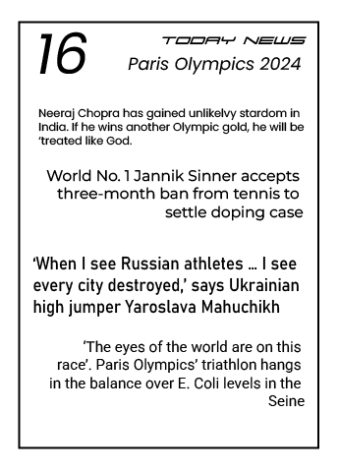
Design a typographic poster that uses a mix of font sizes, styles, and alignments.

Slide 73
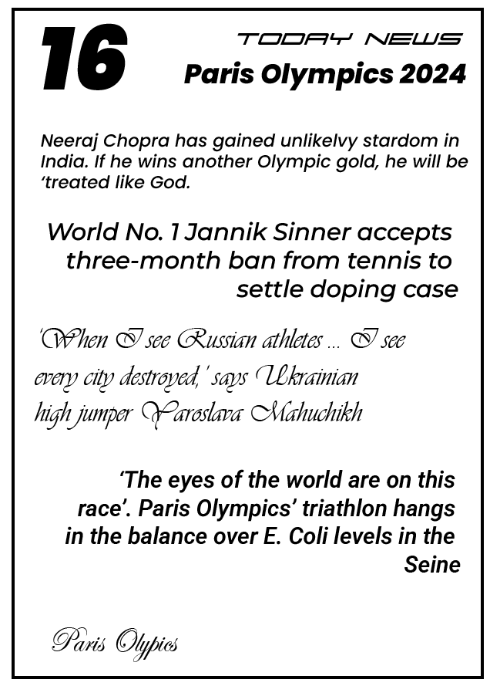
Experiment with bold, italic, and decorative fonts, focusing on creating visual hierarchy.

Slide 74
Typography and Text in Illustrator
Type on a Path Exercise:
Draw a circle and use the Type on a Path tool to create circular text.
Customize the font, size, and positioning of the text around the circle to create a badge or label design.

Slide 75
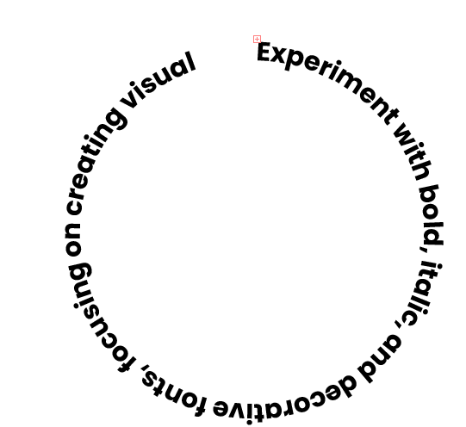
Draw a circle and use the Type on a Path tool to create circular text.

Slide 76
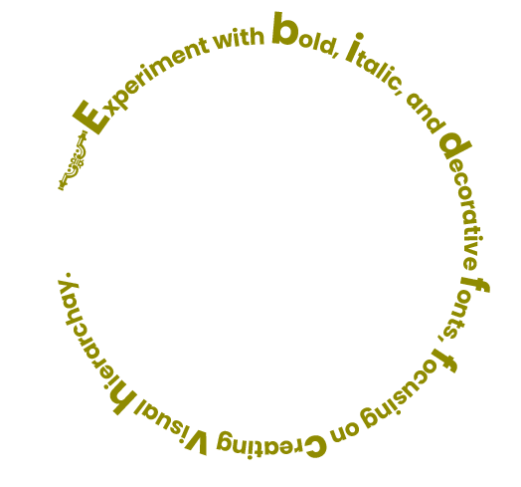
Draw a circle and use the Type on a Path tool to create circular text.

Slide 77
Typography and Text in Illustrator
Custom Text Effects:
Apply effects such as shadows, outlines, and textures to a large heading or title.
Experiment with different font styles and layer effects to create a unique design for a poster or social media post.
Use Appearance panel with effects for editable text effect

Slide 78

Apply effects such as shadows, outlines, and textures to a large heading or title.

Slide 79

Experiment with different font styles and layer effects to create a unique design for a poster or social media post. Use Appearance panel with effects for editable text effect.

Slide 80
Working with Layers, Masks, and Opacity
Theory Assignment:
Layers Panel
Opacity and Blending Modes
Masks

Slide 81
Working with Layers, Masks, and Opacity
Layers Panel:
Explain the importance of layers in Illustrator and how they assist in organizing complex designs.
Describe how layers can be locked, hidden, and rearranged.

Slide 82
Explain the importance of layers in Illustrator and how they assist in organizing complex designs.
Layers are like transparent sheets of paper stacked on top of each other. They allow you to organize your artwork into separate levels, making complex designs much easier to manage.
Importance of Layers
Organization: Layers help you keep track of different elements in your design.
Editing: You can work on one layer without affecting others.
Selective Visibility: You can hide or show layers to focus on specific parts of your artwork or to create different versions of your design.
Stacking Order: Layers control the stacking order of objects. Items on higher layers will appear in front of items on lower layers.

Slide 83
Describe how layers can be locked, hidden, and rearranged.
Locking: Locking a layer prevents any editing to its contents. This is great for protecting elements you don't want to accidentally move or change.
Hiding: Hiding a layer makes its contents invisible. This is useful for temporarily removing elements from view or for creating different versions of your design.
Rearranging: You can easily change the stacking order of layers by dragging them up or down in the Layers panel. This allows you to control which objects appear in front of others.

Slide 84
Working with Layers, Masks, and Opacity
Opacity and Blending Modes:
Define opacity and explain how adjusting it can create transparency effects.
Describe blending modes and their use in achieving different visual effects.

Slide 85
Define opacity and explain how adjusting it can create transparency effects.
Opacity refers to how see-through an object is. A 100% opaque object is completely solid, while a 0% opaque object is completely invisible. Adjusting opacity allows you to create transparency effects, making objects appear translucent.
Creating Transparency
By lowering an object's opacity, you allow underlying artwork to show through. This can be used to create subtle overlays, ghosting effects, or to make elements blend seamlessly into the background.

Slide 86
Describe blending modes and their use in achieving different visual effects.
Blending modes control how colors of overlapping objects interact. They offer a wide range of visual effects beyond simple transparency.
Here are a few common examples:
Multiply: Darkens the colors, often used for shadows or creating a printed look.
Screen: Lightens the colors, useful for highlights or glows.
Overlay: Combines the effects of Multiply and Screen, creating vibrant and high-contrast results.
Difference: Shows the difference between the colors, creating unusual and often psychedelic effects.

Slide 87
Working with Layers, Masks, and Opacity
Masks:
Explain what clipping masks are and when to use them.
Describe how clipping masks can help confine artwork to a specific shape.
Use of Opacity mask in Creating illustration

Slide 88
Explain what clipping masks are and when to use them.
Imagine you have a cookie cutter (your clipping mask) and some dough (your artwork). A clipping mask works similarly: it's a shape that "cuts out" or reveals only the portion of your artwork that falls within its boundaries. Anything outside the mask's shape is hidden.
When to Use Them:
Containing Images: Easily place images within specific shapes (circles, stars, custom outlines) without having to precisely crop the image.
Creating Unique Text Effects: Fill text with images or patterns, giving your typography a visually interesting look.
Designing Logos: Confine elements within a logo shape for a clean and professional appearance.
Isolating Artwork: Focus on specific parts of your design by masking off the rest.

Slide 89
Describe how clipping masks can help confine artwork to a specific shape.
How They Work:
Create a Shape: This will be your clipping mask.
Place Artwork: Position the artwork you want to mask on top of the shape.
Make Clipping Mask: Select both the shape and the artwork, then use the "Make Clipping Mask" command (Object > Clipping Mask > Make).

Slide 90
Use of Opacity mask in Creating illustration
Opacity masks are incredibly useful for creating complex and realistic effects in illustrations:
Textured Surfaces: Use a texture image as an opacity mask to give your objects a realistic surface.
Soft Shadows and Highlights: Create subtle transitions between light and shadow.
Foliage and Hair: Achieve a natural look with complex shapes and varying density.
In summary: Clipping masks confine artwork to a specific shape, while opacity masks control transparency based on grayscale values, both being powerful tools for creating professional and visually appealing designs.

Slide 91
Working with Layers, Masks, and Opacity
Practical Assignment:
Layer Organization Practice
Blending Mode and Opacity Exercise
Clipping Mask Project

Slide 92
Working with Layers, Masks, and Opacity
Layer Organization Practice:
Create a design (e.g., a landscape scene or abstract composition) and organize different elements on separate layers.
Use layer names, locking, and hiding to manage the design effectively

Slide 93

Create a design (e.g., a landscape scene or abstract composition) and organize different elements on separate layers. Use layer names, locking, and hiding to manage the design effectively.

Slide 94
Working with Layers, Masks, and Opacity
Blending Mode and Opacity Exercise:
Design a poster or background image that utilizes blending modes and opacity adjustments for added depth.
Experiment with various blending modes to see how they affect overlapping elements.
Create basic image Using Opacity mask.

Slide 95

Design a poster or background image that utilizes blending modes and opacity adjustments for added depth.

Slide 96
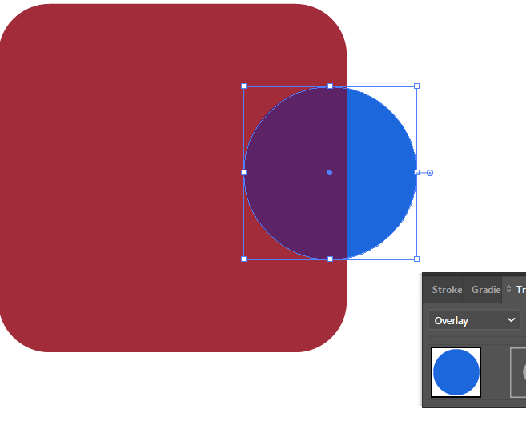
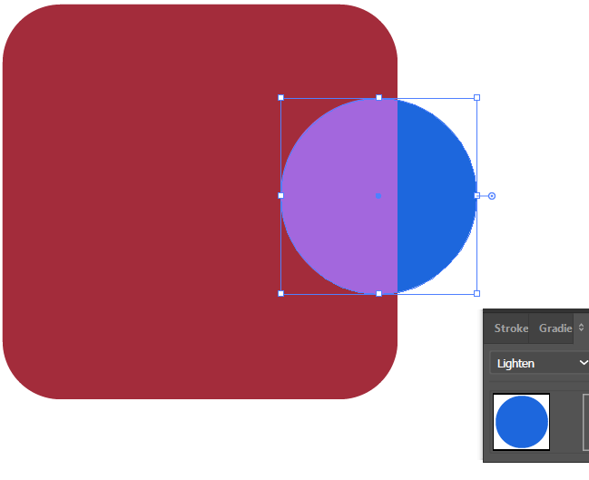
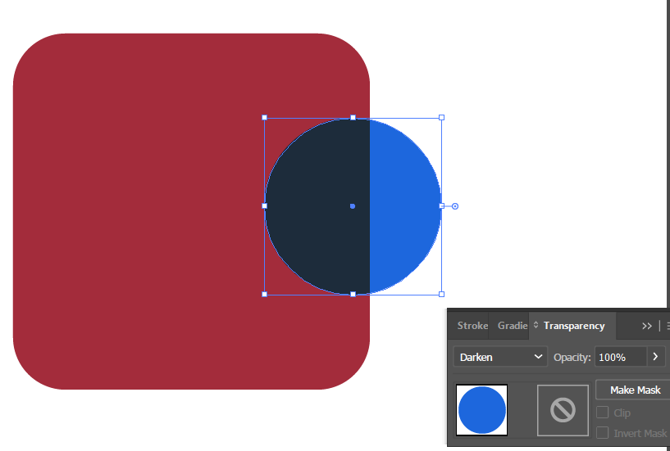
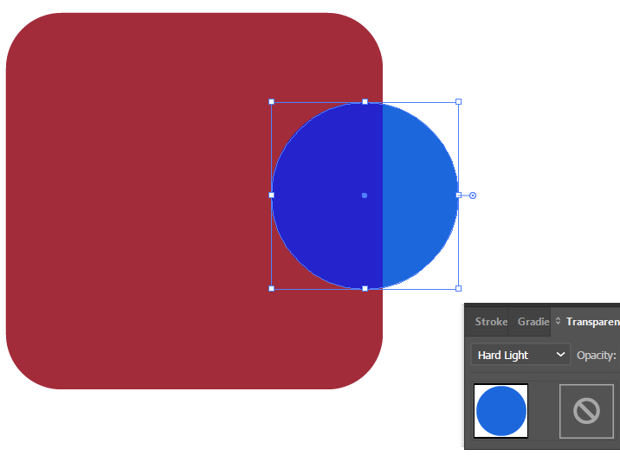
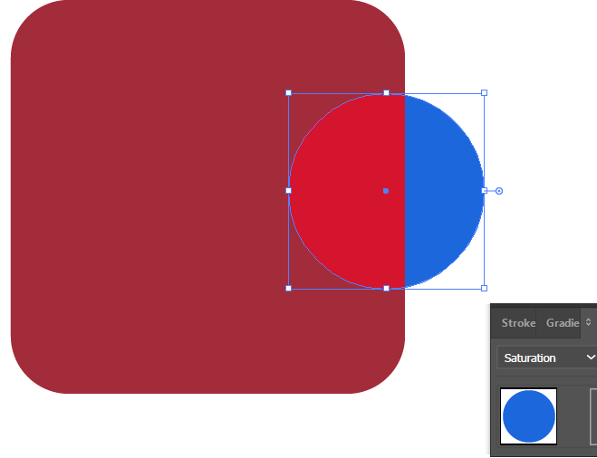
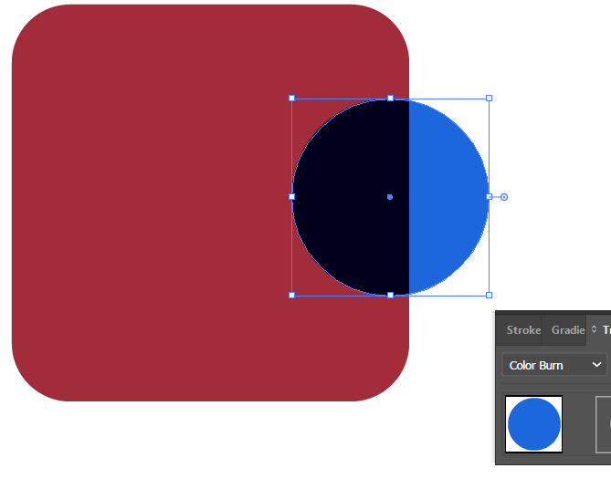
Experiment with various blending modes to see how they affect overlapping elements.

Slide 97
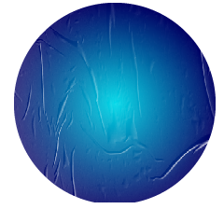
Create basic image Using Opacity mask.

Slide 98
Working with Layers, Masks, and Opacity
Clipping Mask Project:
Use a clipping mask to place an image or texture inside text or a shape.
Create a poster that combines text with a masked background image to achieve an unique visual effect.

Slide 99
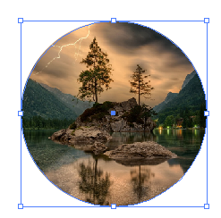
Use a clipping mask to place an image or texture inside text or a shape.

Slide 100

Create a poster that combines text with a masked background image to achieve an unique visual effect.

Slide 101
Icon Design and Vector Illustrations
Theory Assignment:
Importance of Icons in Design
Working with Vectors

Slide 102
Icon Design and Vector Illustrations
Importance of Icons in Design:
Define icons and explain their role in user interfaces and visual communication.
Describe the characteristics of effective icons (e.g., simplicity, scalability, clarity).

Slide 103
Define icons and explain their role in user interfaces and visual communication.
Icons are small, visual symbols that represent objects, actions, or ideas. They're a universal language, quickly conveying meaning without the need for words.
Role in UI and Visual Communication:
User Interfaces (UI): Icons are essential in UIs to guide users, make navigation intuitive, and enhance usability. Think of the icons on your phone or computer representing apps, files, or functions.
Visual Communication: Icons transcend language barriers, making them ideal for communicating information quickly and effectively in various contexts, like signage, maps, or infographics.

Slide 104
Describe the characteristics of effective icons (e.g., simplicity, scalability, clarity).
Characteristics of Effective Icons:
Simplicity: Icons should be clean and easily recognizable, avoiding unnecessary details that can clutter the design.
Scalability: Icons must look good at different sizes, from small app icons to larger website graphics. They should maintain clarity and detail even when scaled up or down.
Clarity: The meaning of an icon should be immediately clear to the user. Avoid abstract or ambiguous symbols that could be misinterpreted.
Consistency: Use a consistent style and design language for all icons within a project.

Slide 105
Icon Design and Vector Illustrations
Working with Vectors:
Explain the difference between vector and raster images, and why vectors are ideal for logos and icons.
Discuss the advantages of creating vector illustrations in Illustrator.

Slide 106
Explain the difference between vector and raster images, and why vectors are ideal for logos and icons.
Raster Images:
These are made up of a grid of tiny pixels, like a digital photograph. When you zoom in, you can see the individual pixels. Raster images are resolution-dependent, meaning they can appear blurry or pixelated when scaled up. Common file types include JPEG, PNG, and GIF.
Vector Images:
These are created using mathematical equations that define lines, curves, and shapes. Vector images are resolution-independent, meaning they can be scaled infinitely without losing quality. They always appear crisp and clear, no matter how much you zoom in. Common file types include AI, SVG, and EPS.

Slide 107
Explain the difference between vector and raster images, and why vectors are ideal for logos and icons.
Why Vectors are Ideal for Logos and Icons:
Scalability: Logos and icons often need to be used in various sizes, from small website icons to large print materials. Vectors ensure they look sharp at any size.
Editability: Vector graphics can be easily edited and modified without losing quality. This is crucial for making revisions or adapting logos for different applications.
Small File Size: Vector files tend to be smaller than raster files, making them efficient for web use and storage.

Slide 108
Discuss the advantages of creating vector illustrations in Illustrator.
Advantages of Vector Illustrations in Illustrator
Precise Control: Illustrator provides tools for precise drawing and manipulation of vector shapes, giving you fine-grained control over your artwork.
Versatility: Create everything from simple icons to complex illustrations. Illustrator is a versatile tool for a wide range of design tasks.
Industry Standard: Illustrator is the industry-standard software for vector graphics, making it compatible with other design tools and workflows.

Slide 109
Icon Design and Vector Illustrations
Practical Assignment:
Design an Icon Set
Vector Illustration Practice

Slide 110
Icon Design and Vector Illustrations
Design an Icon Set:
Create a set of 5–10 icons (e.g., for a weather app, website, or travel app).
Ensure that the icons are consistent in style, size, and line weight.

Slide 111

Create a set of 5–10 icons (e.g., for a weather app, website, or travel app). Ensure that the icons are consistent in style, size, and line weight.

Slide 112
Icon Design and Vector Illustrations
Vector Illustration Practice:
Design a simple vector illustration (e.g., an animal, plant, or cartoon character).
Use the Pen tool, shapes, and colors to bring the illustration to life, focusing on clean lines and simplicity.

Slide 113
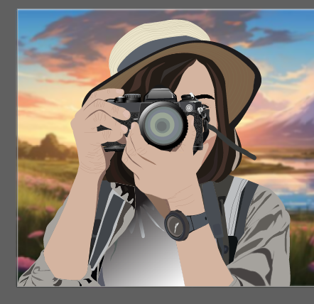
Design a simple vector illustration (e.g., an animal, plant, or cartoon character). Use the Pen tool, shapes, and colors to bring the illustration to life, focusing on clean lines and simplicity.

Slide 114
Thank You !

